Slide 1
Computer Organisation 1 –
What you have to do
Lectures 3 per week; sometimes 2
Tutorials – 1 per week; try to do some of the exercises before coming to the class
Lab – weeks 2 to 5; Computer Aided Learning Package on Binary, hexadecimal and data representation
Teachers: Dave Burns & Sébastien Piccand

Slide 2
Assessment
One hour test in Week 5 (subject to change) on data representation and computer media. Worth 20% of overall grade
End of semester written examination; 80% of overall grade
Module website, for copies of lectures, tutorials, answers, notices: www.csis.ul.ie/modules/cs4211

Slide 3
Brief syllabus
Binary and hex integers and fractions; computer arithmetic; data representation
Computer development; mainframe to PC
Languages - translation from high level to machine code; how programs are executed, through CPU, ALU and memory
I/O devices and drivers
Memory: disc, optical, flash, RAM, cache, registers
Comparison of architectures
Networks and communication
AOB

Slide 4
Supporting material
Textbooks:
  Information Technology, O’Leary and O’Leary. Read chapters 1 to 8
  Structured Computer Organisation. Tanenbaum. 5th Edition
  Principles of Computer Architecture. Murdocca and Heuring.
CAL material on data representation, and other topics at http://www.csis.ul.ie/modules/cs4111/binary

Slide 5
Computer Organisation 1
Aka Computer Architecture
The study of what is done to bridge the gap between people’s needs and languages, and the computer’s abilities and languages.
Seeing computers – different levels, different viewpoints

Slide 6
WHAT CAN COMPUTERS DO?
A sequence of instructions to a computer to carry out a task is called a PROGRAM.
At the bottom level, the type of tasks a computer can carry out is very limited:
  Store a ‘number’ in memory
  Add 2 numbers
  Compare a number with zero
  Copy a value from one part of the computer’s memory to another part.

Slide 7
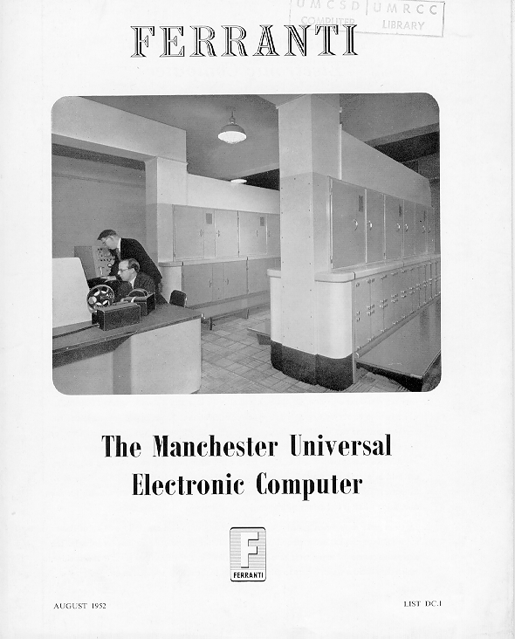
Mainframe and Personal Computers

Slide 8
Advertising for the Ferranti Manchester:
All machines of this type can do THREE things:
They can perform all the operations of arithmetic exceedingly rapidly
They can remember a great many numbers
They can make decisions.

Slide 9
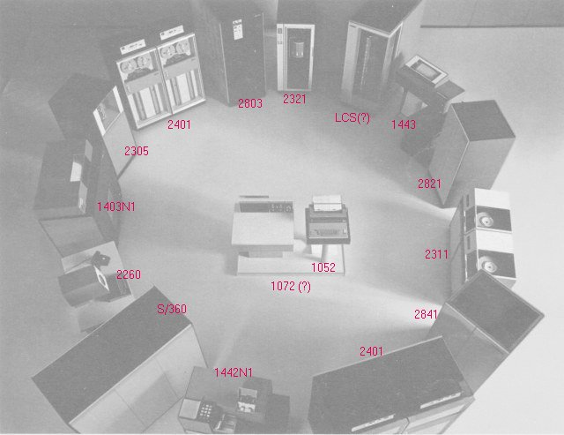

IBM 360/67 when it first came with only 500 kbytes (~ 500,000 char) of RAM.
Compare with PCs of today – 500MB (500 million char) of RAM

Slide 10
What can computers do?
All computer programs must be converted into these basic types of tasks – Add, Compare, Move - before they can be executed.
That is, people want to do X, but computers can do only Y. Some mechanism must be put in place in order for the computer to meet the human need
For example, people read –7 as ‘minus 7’, whereas the computer stores a –7 with a set of symbols thus
1111 1111 1111 1001
The computer works at the level of shuffling patterns of binary digits around – humans are not equipped to think in terms of binary digits, and so a computer has to transform the workings in binary so that we can make sense of them.

Slide 11
Categories of current computers
€1 Disposable
€10 Embedded
€100 Game; personal organisers
€500 Personal Computer
€1k PC
€2k Server
€100k Collection of workstations (COW)
€1m Mainframe
€10m Supercomputer
Greeting card
Watch, car, washing m/c
Home video games, phone, palmtops, digital diaries
Desktop, notebook, phone
Multimedia PC
Network server computer
University department
Bank Data processing
Weather forecasting

Slide 12
Von Neumann – Diagram
Memory Unit
Arithmetic & Logic Unit
Input Unit
Output Unit
Data Path
Control Path
Control Unit

Slide 13
Von Neumann Model
shows the flow of DATA and CONTROL between the various elements needed in a generic architecture.
Five essential components
  Input
    Provides programs & data to computer (keyboard, hard disk, CD-ROM)
  Output
    Where results are sent (screen, HDD, CD-ROM, Data Key)
  Control Unit
    Controls and co-ordinates the ALU, I/O, Memory
  Arithmetic & Logic Unit
    Calculations, comparisons, shifts
  Memory Unit
    Means of storing results, programs etc.

Slide 14
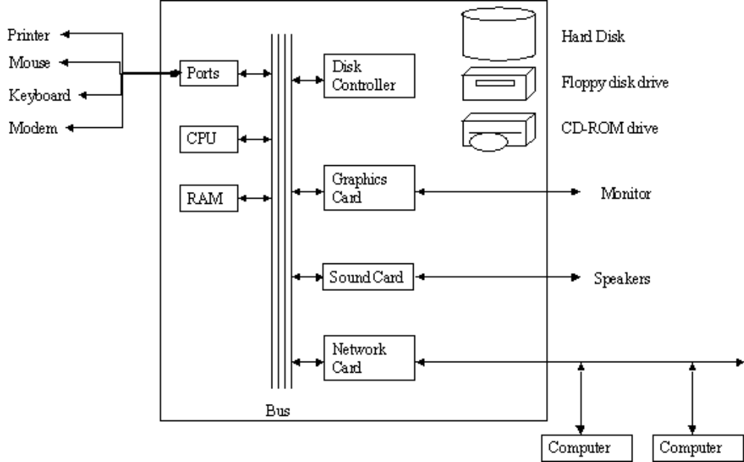

Slide 15
Computer ‘Levels’ from high to low
User level : application programs Level 5
Problem Oriented language (eg JAVA) 4
Assembly language Level 3
Microprogrammed/Hardwired Control 2
Functional Unit (memory, etc) Level 1
Digital Logic Level 0
Transistor/ wiring Level -1

Slide 16
Computer ‘Levels’ from high to low
Level 5 - the User/ Application level
The user reacts with the computer by running programs such as word processors, games. The user sees the computer through the program running – sees little of its internal structure.
Programs/applications are translated into lower levels.

Slide 17
Computer ‘Levels’ from high to low
Level 4 – High-Level Language level
Users write programs for the computer in languages which are similar to human-type languages such as English, maths. Users can get by without a detailed knowledge of how the instructions and data types are implemented.
For example, ADD 7 to X and ADD 7.5 to X (COBOL)
- are implemented quite differently at the lower levels. Why? Programs written in high-level languages are translated (compiled?) into lower level languages or machine language.
High level language programs can be compiled and run on different computers, provided there is a compiler program to carry out the translation.
We say that these high level languages (eg C++, COBOL, JAVA, ADA, BASIC, Pascal, Prolog) are machine independent

Slide 18
Computer ‘Levels’ from high to low
Assembly Language Level 3
This level provides for people to write programs in a language which contains words, codes and abbreviations meaningful to people, rather than the machine language strings of numbers in which the programs of lower levels are written.
Eg mov X, r7 ; Assembly code to add Register value R3
add r3, 7, r3 ; to memory value X mov r3, X
Assembly language differs from high-level in that the programmer has a more intimate knowledge of how the operations are implemented.
So an assembly language is a symbolic form for one of the underlying languages. The program which translates the programmer’s assembly language program to the lower level language is called an Assembler.

Slide 19
Computer ‘Levels’ from high to low
Microarchitecture level 2 - Microprogrammed/hardwired Control
Here we see a collection of Registers (typically from 8 to 32), and a circuit called the ALU – Arithmetic and Logical Unit. The registers are used for local memory, storing intermediate results, for example. The registers are connected to the ALU to form a Data Path.
Say we are adding the contents of memory locations A and B. The contents of these memory locations might be transferred to the registers, while the addition is being carried out.

Slide 20
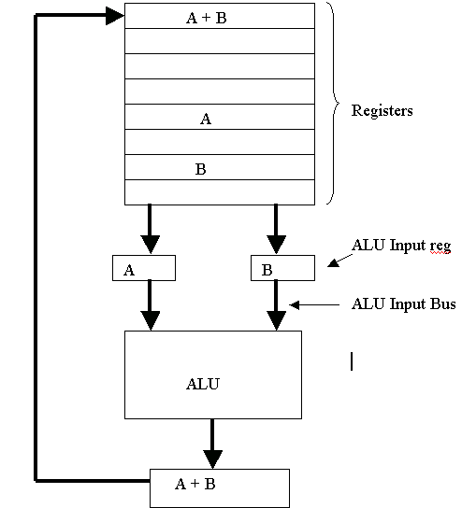
adding the contents of memory locations A and B
Registers and a circuit called the ALU

Slide 21
Instruction Set Architecture (ISA)
The programmer’s view.
Low level (Assembly Language) programmers are concerned with the assembly language instruction set and the functional units (Memory, ALU and Registers) of the computer.
The combination of instruction set and functional units (Memory, ALU, and registers) is known as the Instruction Set Architecture (ISA)

Slide 22
Level 2 – Microprogram/Hard-wired control
‘adding the contents of memory locations A and B’:
The basic operation of the Data Path is to select those registers where the data to be added is stored, copying the values into the ALU, then storing the results back in the memory

Slide 23
Computer ‘Levels’ from high to low
Functional Unit Level 1
How we might look at the computer in terms of its main internal components:
Memory
Arithmetic and Logic Unit
The internal registers.

Slide 24
Computer ‘Levels’ from high to low
Digital Logic Level 0
Logic Gates are built from analogue components such as transistors, but they can be used to represent digital devices.
Analogue means ‘like’ - a continuous impression of a value is represented. Eg a clock with hands
Digital means a discrete value is represented. As digital clock
Eg a simple AND gate takes two input signals and produces one output signal.
If there are 2 positive input signals (ie 1 AND 1) the output will be positive (1). Any negative input (zero) will result in a negative (zero) output.

Slide 25
The Computer Architect’s view
The architect sees that computers are designed as a series of levels, each one built on its predecessors.
The data types, operations, and features of each level are known collectively as its Architecture.
Features that the programmer sees, like how much memory is available, are part of the architecture.
The study of how to design the parts of the computer system visible to the programmer is called Computer Architecture; Computer Architecture is equivalent to Computer Organisation.

Slide 26
Summary
Depending on our point of view, we can see computers at 5 or 6 different levels; the electronic engineer has a completely different view of a computer to an accountant using a spreadsheet. Computer organization is the study of the functional components of the computer, and how they are related to one another.
In order to proceed to understand these levels, and how they are implemented, we must first get a complete understanding of how data is represented in computers, and to do that we have to become familiar with binary and hexadecimal notations.

